Slide 1



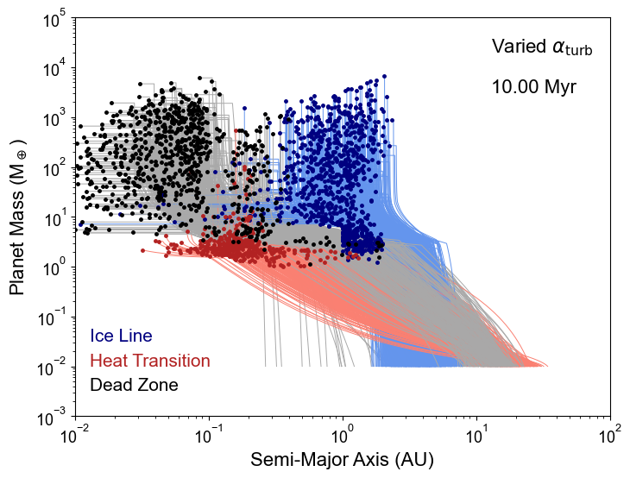
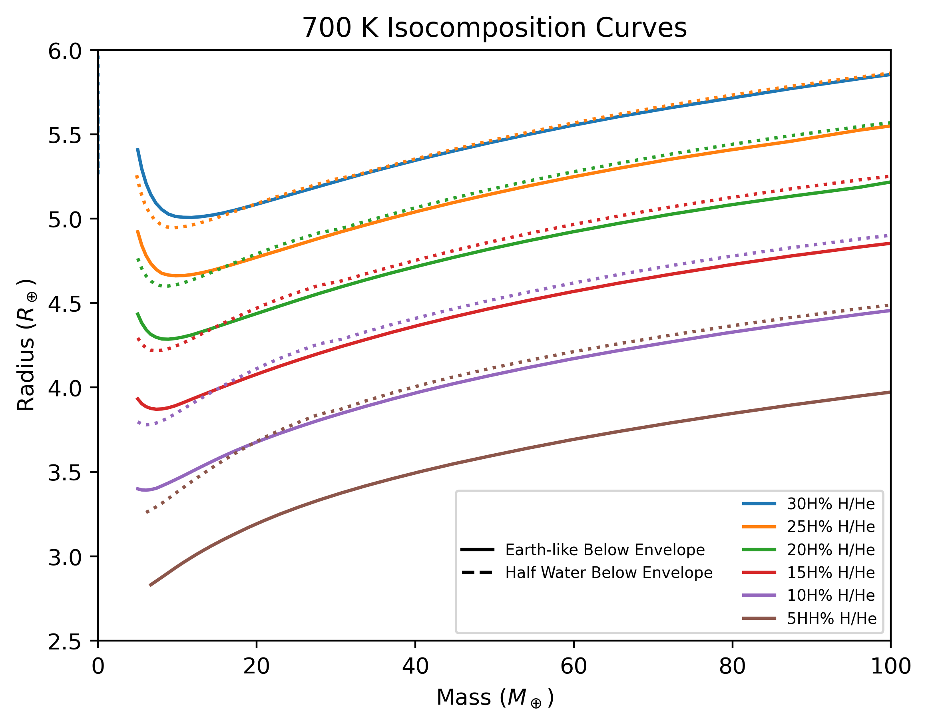
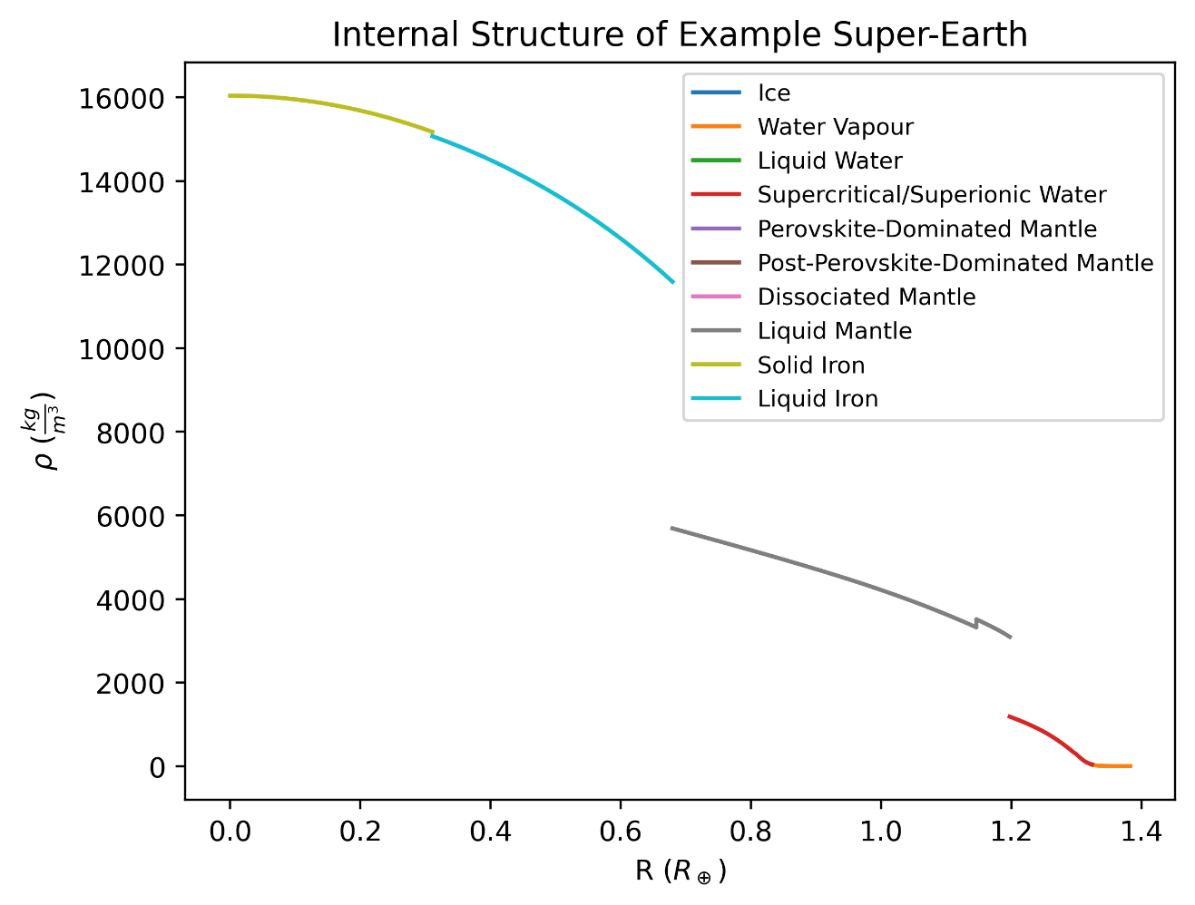
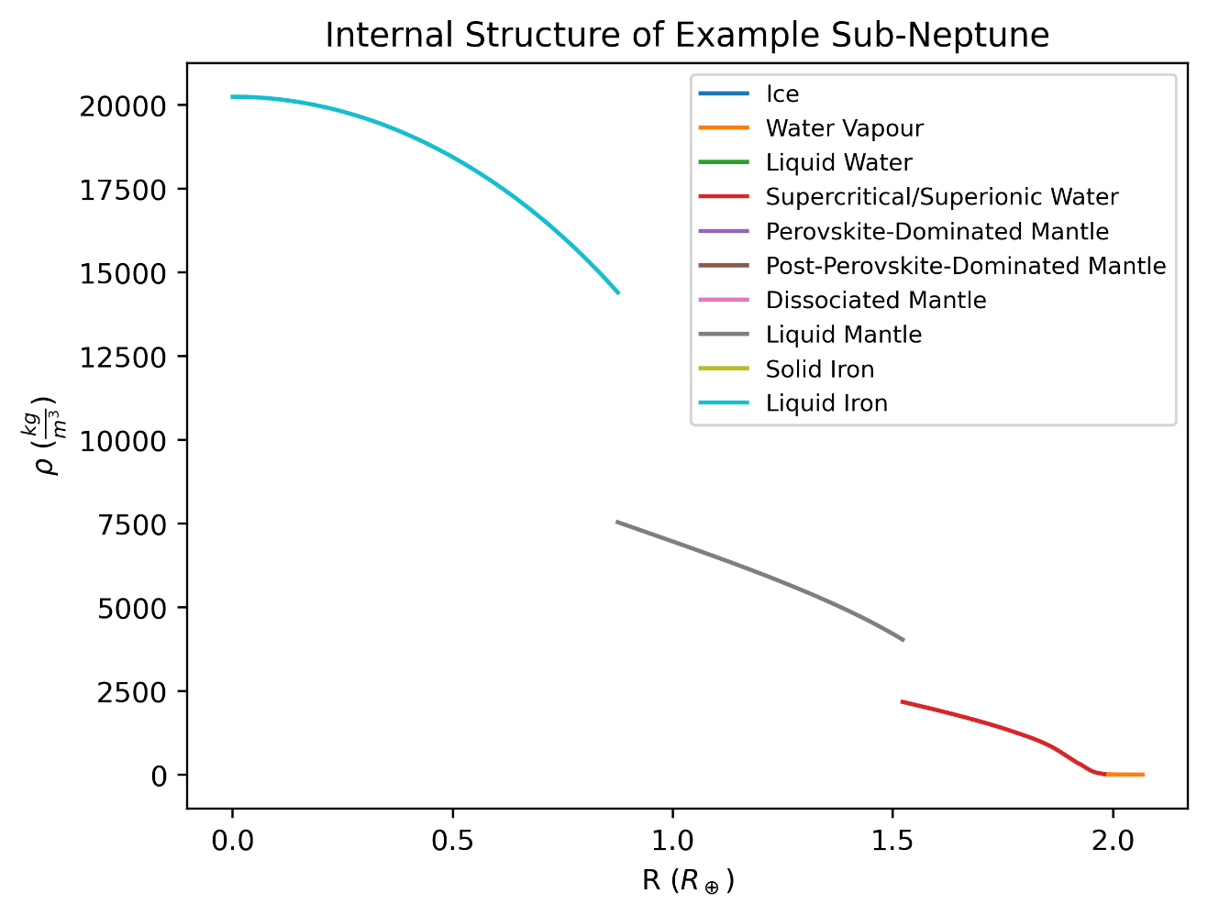
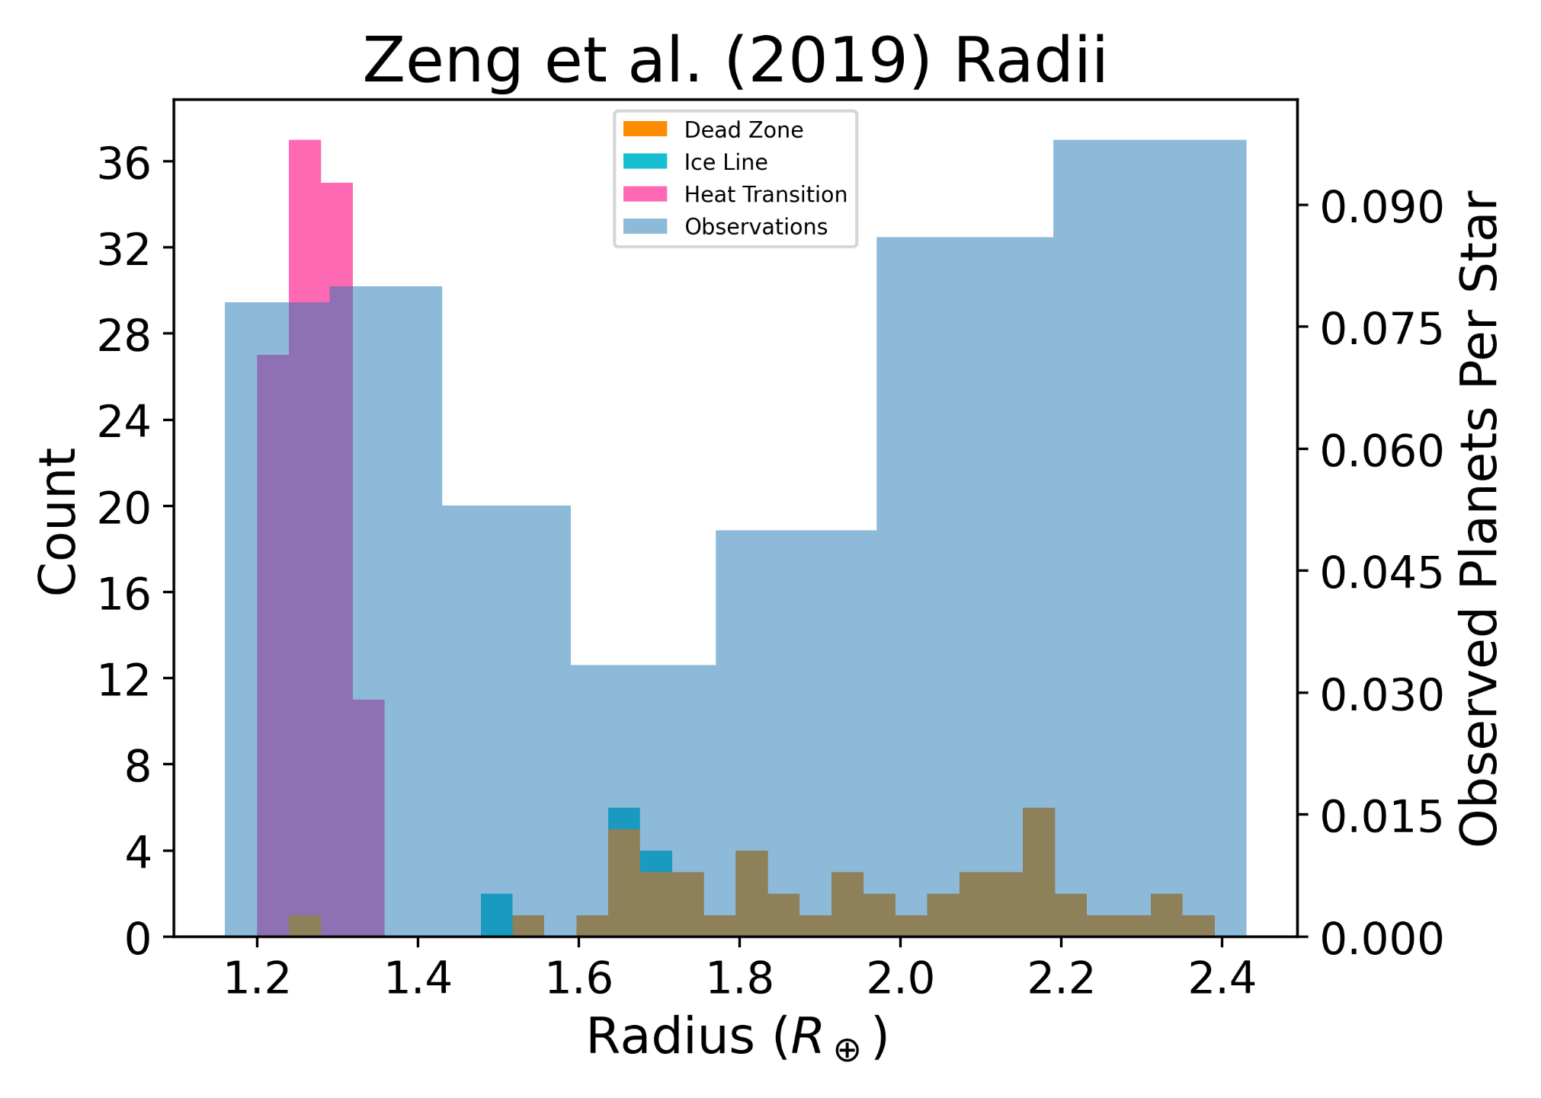
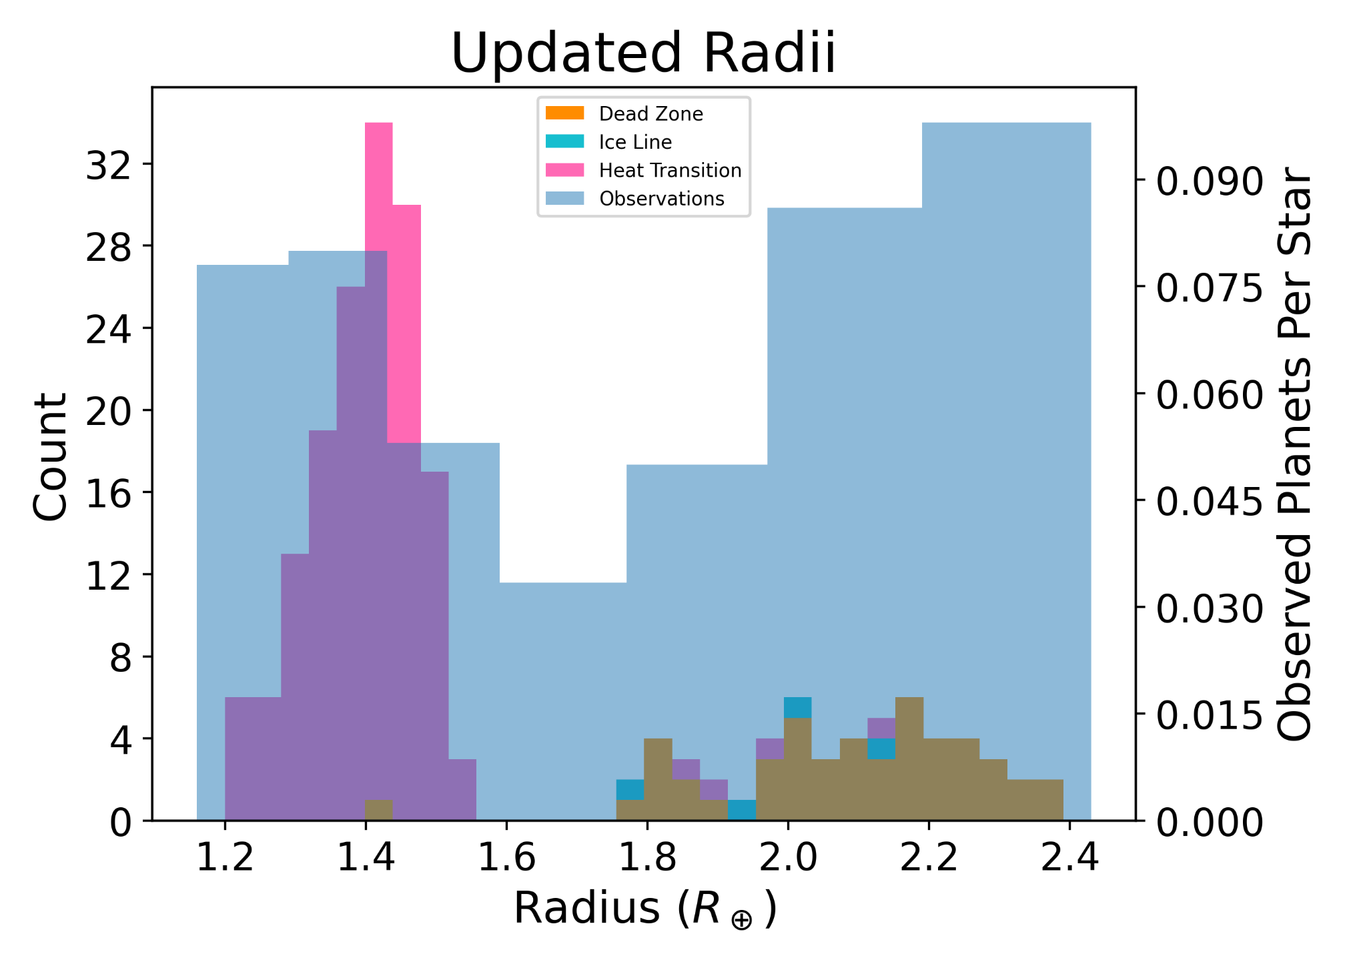
Signs of Migrating Icy Worlds in the Radius Valley
Bennett Skinner, Ralph Pudritz, and Ryan Cloutier
https://tinyurl.com/Bennett-Skinner-PLANETSEDGE25
ALL RESULTS NOT FINAL AND WILL CHANGE BEFORE PUBLICATION!
skinnb1@mcmaster.ca
Radius Valley
Planet Population Synthesis
Distribution of planetary radii is bimodal – “Radius Valley”¹
~1.3 R_{ꚛ} super-Earth peak and ~2.4 R_{ꚛ} sub-Neptune peak¹
Super-Earth ρ consistent w/ Earth-like
Sub-Neptune ρ consistent w/ H/He OR water envelope
Sub-Neptune composition depends on valley formation
Atmospheric mass loss → H/He-rich
Water-rich formation → water-rich
FGK slope w/ instellation consistent w/ envelope mass loss^{2,3}
M slope different v. FGK stars⁴, possible water-rich formation
Both mechanisms could contribute⁵
Simulate planet formation, create synthetic population
McMaster Planet Population Synthesis Model (MPPSM)⁶
Planetesimal accretion in disk around sunlike star
One lunar-mass embryo/disk
Power-law disk evolved via turbulent viscosity
Disk wind-driven advection and mass loss
Planets form in planet traps where disk conditions change⁷
Ice Line: Water vapour → condensed
Heat Transition: Heat via viscous dissipation → irradiation
Dead-Active Zone: MRI inactive → MRI active
Has lost atmosphere
Has retained atmosphere
MPPSM Planet Time Series
Atmospheric Mass Loss
Alessi & Pudritz (2022) Fig. 7⁶
Water-Rich Formation
Formed mostly inside iceline
Formed mostly outside iceline
Interior Structure Updates
New Mass-Radius Curves
Determine planetary radii from MPPSM output parameters⁷
Now use most modern Equations of State (EOS)⁸⁻²⁵
Experimental measurements of ρ using diamond anvils²²
Apply Density Functional Theory (DFT) to high pressures²³
More advanced model
Mantle composition via Gibbs free energy minimization¹³
Non-grey irradiated atmosphere²⁶⁻²⁹
Thermal effects (including melting) within mantle, core⁸⁻²⁵
FeS in the core^{21,23}
Prescription for rotation³⁰⁻³¹
Transit radii calculated to compare to observations²⁶
Radii calculated for varying masses, compositions
Current mass-radius curves old EOS or not made for high T
Synthetic Radius Valley
Too broad
Calculated radii of MPPSM planets w/ new interior structure
Is radius valley replicated without H/He-rich planets?
Peak radii approximated but relative occurrence incorrect
Water worlds could be secondary FGK sub-Neptune source
Updated interior structure model required for radius valley
W/o winds, no radius valley b/c less migration
Planets too hot, too water-rich
H/He-enveloped planets dominate
Observations from
Fulton et al. (2017)¹
Update Interior Structure Model
Observations from
Fulton et al. (2017)¹
Acknowledgements & References
We would like to thank Matthew Alessi for providing code used in MPPSM; Komal Bali and Caroline Dorn for providing tabulated MR relationships from their interior structure model; and Jonas Haldemann for insights about water equations of state. We would also like to thank the creators of the BICEPS model, Jonas Haldemann, Caroline Dorn, Julia Venturini, Yann Alibert, and Willy Benz, for coagulating many of the EOS we use in our model.
¹Fulton, B. J., Petigura, E. A., Howard, A. W., Isaacson, H., Marcy, G. W., Cargile, P. A., Hebb, L., Weiss, L. M., Johnson, J. A., Morton, T. D., Sinukoff, E., Crossfield, I. J. M., and Hirsch, L. A. (2017). The California-Kepler Survey. III. A Gap in the Radius Distribution of Small Planets. , 154(3):109. ²Lopez, E. D. and Rice, K. (2018). How formation time-scales affect the period dependence of the transition between rocky super-Earths and gaseous sub-Neptunesand implications for η⊕. ³Gupta, A. and Schlichting, H. E. (2019). Sculpting the valley in the radius distribution of small exoplanets as a by-product of planet formation: the core-powered mass-loss mechanism. ⁴Cloutier, R. and Menou, K. (2020). Evolution of the Radius Valley around Low-mass Stars from Kepler and K2. ⁵Burn, R., Mordasini, C., Mishra, L., Haldemann, J., Venturini, J., Emsenhuber, A., and Henning, T. (2024). A radius valley between migrated steam worlds and evaporated rocky cores. ⁶Alessi, M. and Pudritz, R. E. (2022). Combined effects of disc winds and turbulence-driven accretion on planet populations. ⁷Alessi, M., Pudritz, R. E., and Cridland, A. J. (2020b). Formation of planetary populations - II. Effects of initial disc size and radial dust drift. ⁸Chabrier, G., Mazevet, S., and Soubiran, F. (2019). A New Equation of State for Dense Hydrogen-Helium Mixtures. ⁹Chabrier, G. and Debras, F. (2021). A New Equation of State for Dense Hydrogen-Helium Mixtures. II. Taking into Account Hydrogen-Helium Interactions. ¹⁰Howard, S. and Guillot, T. (2023). Accounting for non-ideal mixing effects in the hydrogen-helium equation of state. ¹¹Haldemann, J., Alibert, Y., Mordasini, C., and Benz, W. (2020). AQUA: a collection of H2O equations of state for planetary models. ¹²Stixrude, L. and Lithgow-Bertelloni, C. (2024). Thermodynamics of mantle minerals - III: the role of iron. ¹³Connolly, J. A. D. (2009). The geodynamic equation of state: What and how. ¹⁴Ichikawa, H. and Tsuchiya, T. (2020). Ab Initio Thermoelasticity of Liquid Iron-Nickel-Light Element Alloys. ¹⁵Sakai, T., Dekura, H., and Hirao, N. (2016). Experimental and theoretical thermal equations of state of MgSiO₃ post-perovskite at multi-megabar pressures. ¹⁶Fischer, R. A., Campbell, A. J., Shofner, G. A., Lord, O. T., Dera, P., and Prakapenka, V. B. (2011). Equation of state and phase diagram of FeO. ¹⁷Musella, R., Mazevet, S., and Guyot, F. (2019). Physical properties of MgO at deep planetary conditions. ¹⁸Melosh, H. J. (2007). A hydrocode equation of state for SiO2. ¹⁹Faik, S., Tauschwitz, A., and Iosilevskiy, I. (2018). The equation of state package FEOS for high energy density matter. ²⁰Stewart, S., Davies, E., Duncan, M., Lock, S., Root, S., Townsend, J., Kraus, R., Caracas, R., and Jacobsen, S. (2020). The shock physics of giant impacts: Key requirements for the equations of state. ²¹Ichikawa, H. and Tsuchiya, T. (2020). Ab Initio Thermoelasticity of Liquid Iron-Nickel-Light Element Alloys. ²²Kuwayama, Y., Morard, G., Nakajima, Y., Hirose, K., Baron, A. Q. R., Kawaguchi, S. I., Tsuchiya, T., Ishikawa, D., Hirao, N., and Ohishi, Y. (2020). Equation of State of Liquid Iron under Extreme Conditions. ²³Hakim, K., Rivoldini, A., Van Hoolst, T., Cottenier, S., Jaeken, J., Chust, T., and Steinle-Neumann, G. (2018). A new ab initio equation of state of hcp-Fe and its implication on the interior structure and mass-radius relations of rocky super-Earths. ²⁴Fei, Y., Murphy, C., Shibazaki, Y., Shahar, A., and Huang, H. (2016). Thermal equation of state of hcp-iron: Constraint on the density deficit of Earth’s solid inner core. ²⁵Dorogokupets, P. I., Dymshits, A. M., Litasov, K. D., and Sokolova, T. S. (2017). Thermodynamics and Equations of State of Iron to 350 GPa and 6000 K. ²⁶Guillot, T. (2010). On the radiative equilibrium of irradiated planetary atmospheres. ²⁷Parmentier, V. and Guillot, T. (2014). A non-grey analytical model for irradiated atmospheres. I. Derivation. ²⁸Parmentier, V., Guillot, T., Fortney, J. J., and Marley, M. S. (2015). A non-grey analytical model for irradiated atmospheres. II. Analytical vs. numerical solutions. ²⁹Freedman, R. S., Lustig-Yaeger, J., Fortney, J. J., Lupu, R. E., Marley, M. S., and Lodders, K. (2014). Gaseous Mean Opacities for Giant Planet and Ultracool Dwarf Atmospheres over a Range of Metallicities and Temperatures.
³⁰Paxton, B., Cantiello, M., Arras, P., Bildsten, L., Brown, E. F., Dotter, A., Mankovich, C., Montgomery, M. H., Stello, D., Timmes, F. X., and Townsend, R. (2013). Modules for Experiments in Stellar Astrophysics (MESA): Planets, Oscillations, Rotation, and Massive Stars. ³¹Paxton, B., Smolec, R., Schwab, J., Gautschy, A., Bildsten, L., Cantiello, M., Dotter, A., Farmer, R., Goldberg, J. A., Jermyn, A. S., Kanbur, S. M., Marchant, P., Thoul, A., Townsend, R. H. D., Wolf, W. M., Zhang, M., and Timmes, F. X. (2019). Modules for Experiments in Stellar Astrophysics (MESA): Pulsating Variable Stars, Rotation, Convective Boundaries, and Energy Conservation.
Future Work
Incorporate metals in H/He envelope
Non-radiogenic heating
Implement active-dead zone boundary
Create and run MPPSM for M dwarf stars
Statistically quantify synthetic-observational discrepancy
Apply improved interior structure to MPPSM advances
Pebble accretion, new wind prescription, N-body, etc.

